Slide 1
Sales & Customer Analytics
Deraah Retail Group | SQL Server, Power BI, DAX
github.com/rehamessa/deraah-h1fy26-customer-analytics
Notes:
One line: I turned messy retail CSVs into a trusted warehouse and a four-page dashboard that answers four business questions.

Slide 2
Four questions the business needs answered
1
Is growth real?
2
Who drives revenue?
How much of the sales growth is left once new stores are taken out?
Which customers bring the sales, and do new customers come back?
3
Which stores need help?
4
Do promotions pay off?
Where are the strong and weak branches, by region, city and format?
Do they lift sales, or just discount sales that would have happened anyway?
Notes:
Frame the project as questions first, then show how each page answers one.

Slide 3
From raw files to a dashboard in four layers
CSV files
stg
slv
marts
Power BI
Bronze: loaded as-is
Silver: clean views, one rule per fix
Gold: star schema
4 pages, 12 measures, RLS
Why it matters: every number on the dashboard can be traced back to a raw row, and any cleaning rule can be changed in one place.
Notes:
Medallion idea: keep raw data untouched, clean it in views where each rule is visible, then model it for reporting.

Slide 4
11 data quality issues found, logged and fixed
Test branch B999 and all its lines removed
Duplicate customers merged on lowercased email, earliest join date kept
Duplicate transaction IDs removed
Sales dated after the 30 Jun 2026 reporting date dropped
Orphan SKUs with no product row dropped
Mixed-sign discounts fixed with ABS()
net_amount recomputed, is_return fixed where qty < 0
11
issues logged, each with a decision
Impact analysis shows what each issue would do to sales, customers and growth if left unfixed.
Notes:
Each issue is in the DQ log with the decision made. A second workbook shows what each would do to the numbers if left alone.

Slide 5
A star schema built for reporting
dim_products
Dim_promotions
Fact_transaction_lines
Fact_transactions
Dim_branches
Dim_customers
DimDate
Plus RFM, CohortOffset and a measures table. DimDate is marked as the date table.
Notes:
Lines carry product and promotion; receipts carry branch, customer and date. DimDate is the marked date table.

Slide 6
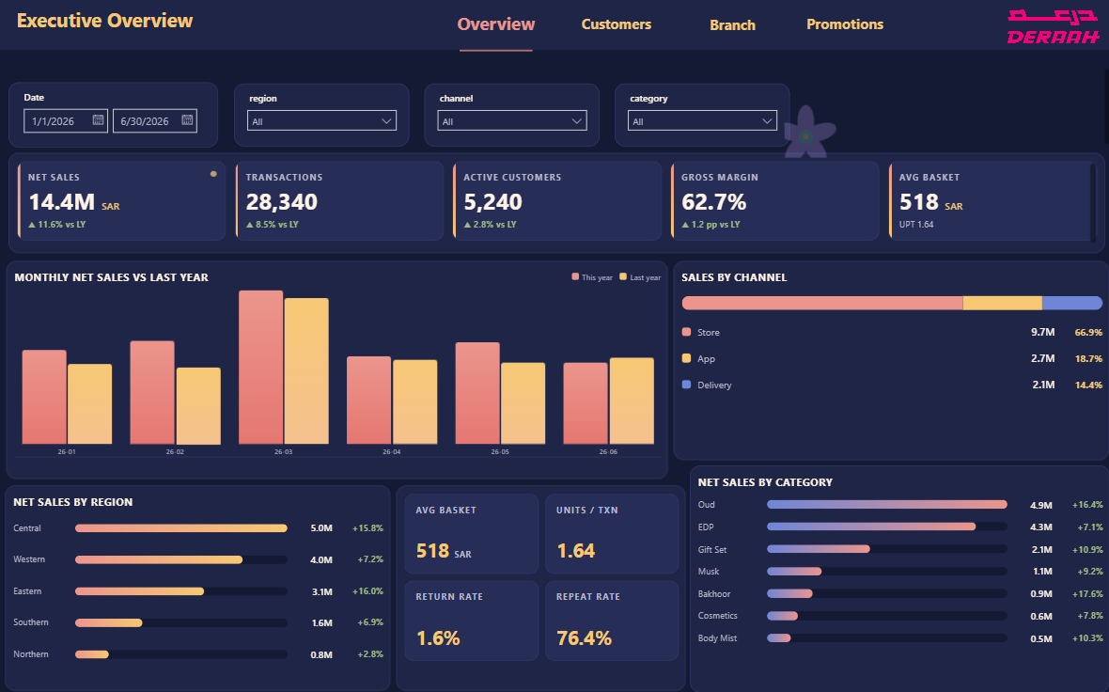
Executive: the big picture
14.4M SAR net sales, up 11.6% on last year
Gross margin 62.7%, average basket 518 SAR
Central leads regions at 5.0M; Oud leads categories at 4.9M
Notes:
Net sales, margin, basket, regions and categories. Central is the biggest region; Oud the biggest category.

Slide 7
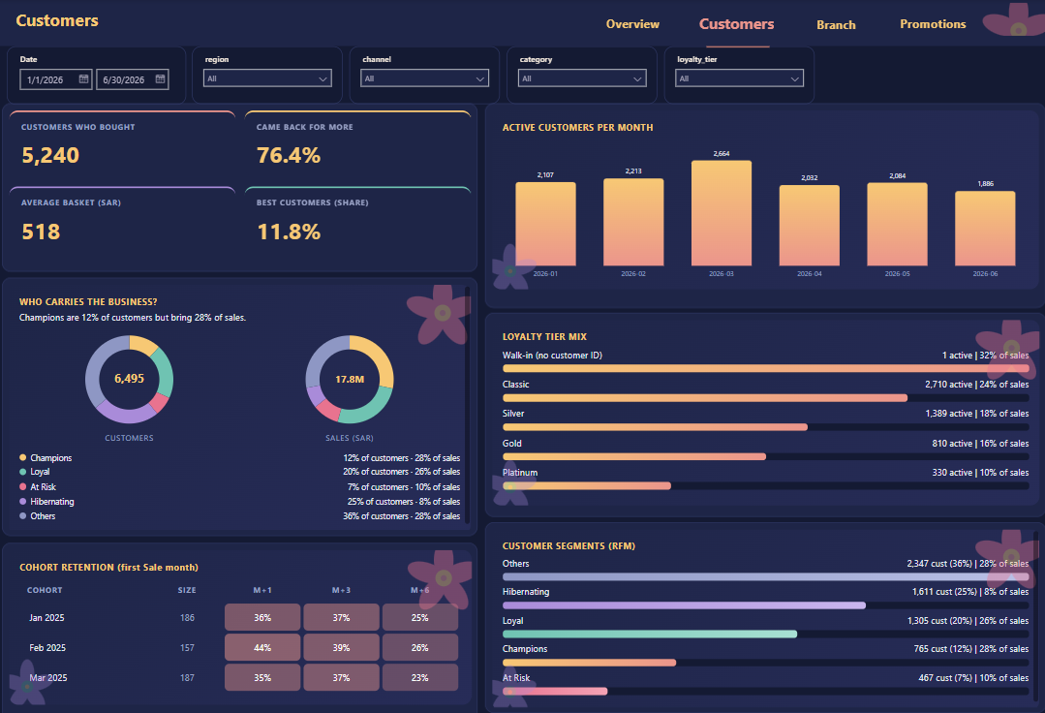
Customers: who carries the business
Champions are 12% of customers but 28% of sales
76.4% of buyers came back for more
Early cohorts: about a quarter still buying after 6 months
Notes:
RFM segments, cohorts and tiers. Stress that Champions are small but valuable.

Slide 8
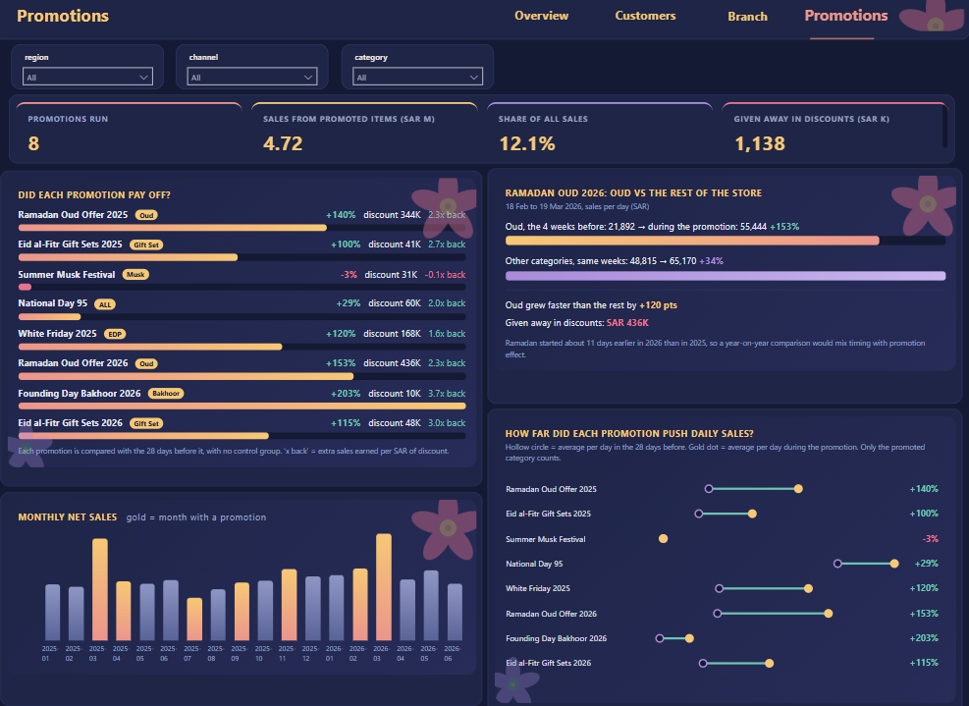
Promotions: did each one pay off?
8 promotions: 12.1% of sales, 1.14M SAR given in discounts
Oud 2026: +153% vs +34% for other categories
Ramadan started about 11 days earlier, so part of the lift is timing
Notes:
Lift is the promo window per day against the 28 days before, for the promoted category only. No control group, so timing matters.

Slide 9
Headline growth is not the same as real growth
HEADLINE GROWTH
COMPARABLE-STORE GROWTH
+11.6%
+5.9%
all stores
35 of 40 branches
About half of the headline growth comes from new stores. A branch counts as comparable only if it opened on or before 1 Jan 2025 and was still open on 30 Jun 2026.
Notes:
LFL = open on or before 1 Jan 2025 and still open on 30 Jun 2026. 35 of 40 branches qualify. New stores flatter the total.

Slide 10
Measures, drill-down and security
12 core DAX measures
Built to be used
Net Sales
Net Sales LY
YoY %
Average Basket
UPT
Gross Margin %
Active Customers
Repeat Rate %
LFL Net Sales
LFL Growth %
Transactions
Return Rate %
Row-level security: a Region Manager sees only their region
Custom HTML and SVG cards in a dusk theme
Notes:
Twelve core measures grouped in display folders. RLS filters by region. The cards are DAX measures that return HTML and SVG.

